Slide 1

English for Information Technology
Week
4
Dept of information management, Yuanze University

Slide 2

BBC Learning English

Slide 3
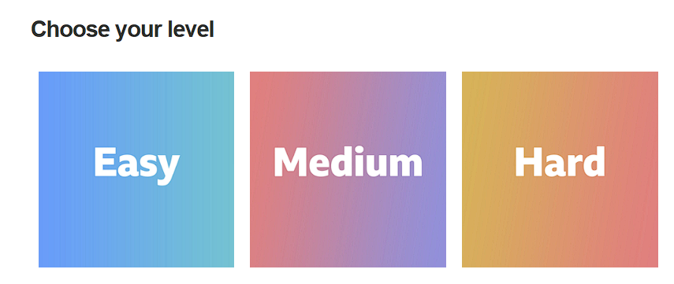
BBC Learning English

Slide 4
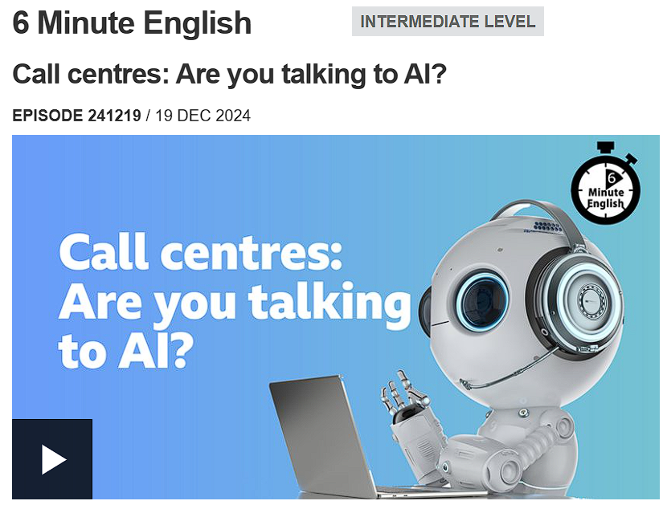
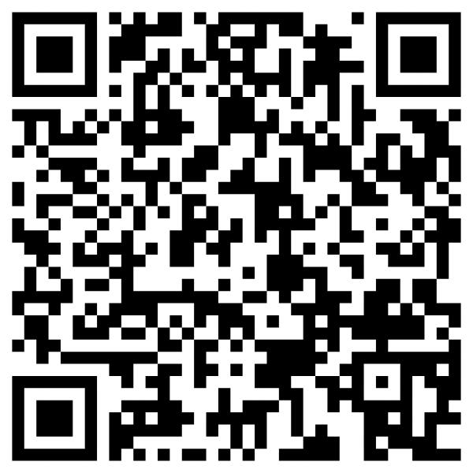
Online resources for today
Original Article

Slide 5
Listen
Let’s listen to the original video
對話討論了人工智慧（AI）對電話客服中心工作的影響。
當人們打電話給公司並被要求等待時，通常會感到沮喪。
傳統上，客服人員會處理這些問題，但現在AI正逐漸取代這項工作，這對印度和菲律賓等依賴客服中心產業的國家造成了問題。
菲律賓客服中心工會主席Mylene Cabalona表達了她對AI將取代人類工作的擔憂，並指出客服工作壓力大，因為要應對憤怒的客戶，同時還要被AI監控。
她引用一項研究，稱約27%的客服人員可能因此失業。然而，Mylene認為AI無法完全取代人類，因為它缺乏同理心，這是人類獨有的重要特質。

Slide 6
Vocabulary
Queue
Definition: A line of people or things waiting for their turn.
Example: "I had to wait in a long queue at the supermarket checkout."---
Frustrated
Definition: Feeling annoyed or impatient because you are unable to achieve something.
Example: "He felt frustrated when his computer crashed and he lost all his work."---
artificial intelligence (AI)
Definition: Computer systems that can do things that usually require human thinking, like understanding language or solving problems.
Example: "Many modern smartphones use artificial intelligence for features like voice assistants."---
Aggravated
Definition: Made to feel angry or annoyed, especially by a situation or person.
Example: "The long wait on the phone made the customer even more aggravated."
pacify
Definition: To make someone who is angry or upset calm and peaceful again.
Example: "The mother tried to pacify her crying baby with a lullaby."---
displace
Definition: To force something or someone out of their usual place or role.
Example: "New technology often displaces older methods and sometimes workers."---
empathy
Definition: The ability to understand and share the feelings of another person.
Example: "A good friend shows empathy when you are going through a difficult time."---
filler words
Definition: Words or phrases like "um," "ah," or "you know" that speakers use to pause or think during a conversation.
Example: "Using too many filler words can make a speaker sound less confident."

Slide 7
Speak 1: Dealing with Difficult Situations
1. Being on Hold: When you call a company, you might hear the message, "Your call is important to us. You are number 89 in the queue".
◦ Do you agree with Phil that knowing your number in the queue makes waiting better? Why or why not?
2. Calming Angry Clients: Call center workers must deal with clients who are angry and "yelling"
◦ What does it mean to "pacify" someone?
◦ If you had to "pacify" an angry customer, what simple words or actions would you use to calm them down?
3. Mental Stress: Mylene Cabalona mentions the "mental stress" of dealing with aggravated clients.
◦ What makes this job so stressful for the human worker?
4. AI Watching: Mylene also says that the difficult part of the job is knowing that the conversation is being monitored by an AI.
◦ How might being watched by a machine make a person feel more nervous or stressed while they work?

Slide 8
Speak 2: AI and Job Loss
5. Who is in Charge? The program asks: who is really in charge at the call centre, humans or AI?
◦ Do you think companies will let AI take over completely, or will humans always be needed?
6. Economic Impact: Call center jobs are a big part of the economy in countries like the Philippines and India.
◦ If AI starts to "displace workers", how could this hurt the entire economy of those countries?
7. The Timeline: Mylene fears that AI will replace workers "in the near future".
◦ What does "in the near future" mean?
◦ Do you think 27% of call center jobs will be lost very soon, or will it take longer?

Slide 9
Speak 3: Human Skills vs. Machine Skills
8. Empathy: Mylene argues that AI will never fully replace humans because it lacks "empathy".
◦ What does it mean to be "empathetic"?
◦ In a difficult situation, why might a client feel more compassionate when talking to a person instead of a robot?
9. AI Support: If AI can't show empathy, should companies use AI to help human workers instead of replacing them?
◦ What kinds of tasks could AI handle so the human worker can focus on being empathetic?

Slide 10
Speak 4: Language and Conversation
10. Filler Words: Mylene uses the phrase "you know" a lot. This is a filler word.
◦ Why do people use filler words like "um," "ah," or "you know" when speaking?
◦ Do you use them more when you are thinking hard or when you are nervous?
11. Adding Emphasis: Phil defines "as a matter of fact" as a phrase used to add emphasis or give more detail.
◦ Think of a fact about your day. How could you use the phrase "as a matter of fact" to make your statement stronger?

Slide 11
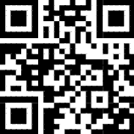
Simulated Speaking Contest
Group A: Positive views towards AI’s role in certain segments of the job market
Group B: Negative, skeptical views towards AI’s role in certain segments of the job market,
https://tinyurl.com/y24eshfs

Slide 12

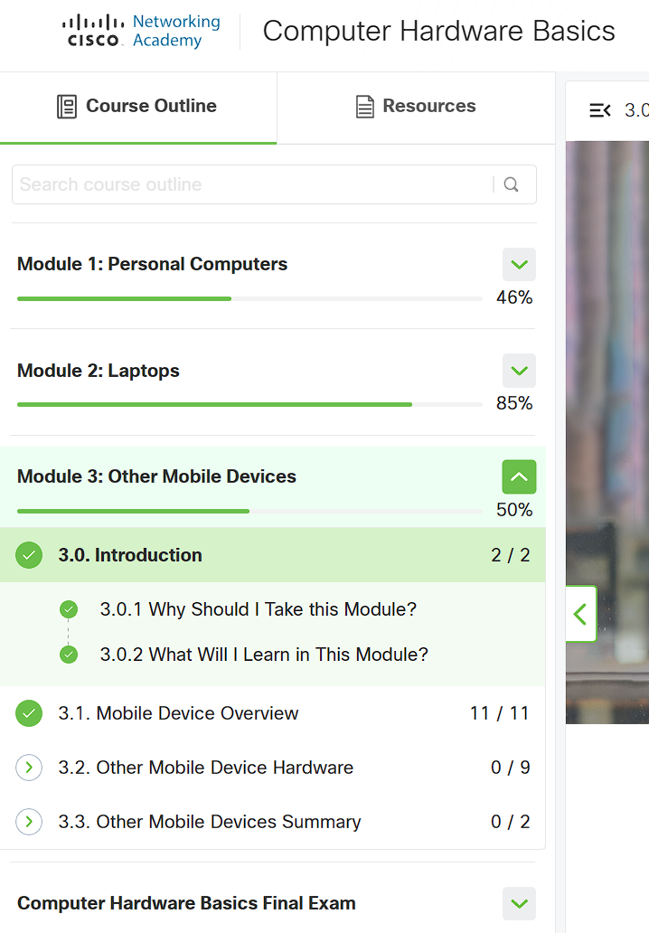
Update on CN Academy
Cisco Networking Academy: Computer Hardware Basics

